Slide 1
Building Maximum Entropy
Text Classifier
Using Semi-supervised Learning
Zhang, Xinhua
For PhD Qualifying Exam Term Paper

Slide 2
Road map
Introduction: background and application
Semi-supervised learning, especially for text classification (survey)
Maximum Entropy Models (survey)
Combining semi-supervised learning and maximum entropy models (new)
Summary

Slide 3
Road map
Introduction: background and application
Semi-supervised learning, esp. for text classification (survey)
Maximum Entropy Models (survey)
Combining semi-supervised learning and maximum entropy models (new)
Summary

Slide 4
Introduction:
Application of text classification
Text classification is useful, widely applied:
  cataloging news articles (Lewis & Gale, 1994; Joachims, 1998b);
  classifying web pages into a symbolic ontology (Craven et al., 2000);
  finding a person’s homepage (Shavlik & Eliassi-Rad, 1998);
  automatically learning the reading interests of users (Lang, 1995; Pazzani et al., 1996);
  automatically threading and filtering email by content (Lewis & Knowles, 1997; Sahami et al., 1998);
  book recommendation (Mooney & Roy, 2000).

Slide 5
Early ways of text classification
Early days: manual construction of rule sets. (e.g., if advertisement appears, then filtered).
Hand-coding text classifiers in a rule-based style is impractical. Also, inducing and formulating the rules from examples are time and labor consuming.

Slide 6
Supervised learning for text classification
Using supervised learning
  Require a large or prohibitive number of labeled examples, time/labor-consuming.
  E.g., (Lang, 1995) after a person read and hand-labeled about 1000 articles, a learned classifier achieved an accuracy of about 50% when making predictions for only the top 10% of documents about which it was most confident.

Slide 7
What about using unlabeled data?
Unlabeled data are abundant and easily available, may be useful to improve classification.
  Published works prove that it helps.
Why do unlabeled data help?
  Co-occurrence might explain something.
  Search on Google,
    ‘Sugar and sauce’ returns 1,390,000 results
    ‘Sugar and math’ returns 191,000 results
    though math is a more popular word than sauce

Slide 8
Using co-occurrence and pitfalls
Simple idea: when A often co-occurs with B (a fact that can be found by using unlabeled data) and we know articles containing A are often interesting, then probably articles containing B are also interesting.
Problem:
  Most current models using unlabeled data are based on problem-specific assumptions, which causes instability across tasks.

Slide 9
Road map
Introduction: background and application
Semi-supervised learning, especially for text classification (survey)
Maximum Entropy Models (survey)
Combining semi-supervised learning and maximum entropy models (new)
Summary

Slide 10
Generative and discriminative semi-supervised learning models
Generative semi-supervised learning
  Expectation-maximization algorithm, which can fill the missing value using maximum likelihood
Discriminative semi-supervised learning
  Transductive Support Vector Machine (TSVM)
    finding the linear separator between the labeled examples of each class that maximizes the margin over both the labeled and unlabeled examples
(Nigam, 2001)
(Vapnik, 1998)

Slide 11
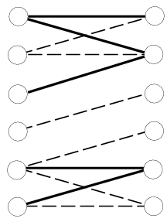
Other semi-supervised learning models
Co-training
Active learning
Reduce overfitting
(Blum & Mitchell, 1998)
e.g., (Schohn & Cohn, 2000)
e.g. (Schuurmans
& Southey, 2000)

Slide 12
Theoretical value of unlabeled data
Unlabeled data help in some cases, but not all.
For class probability parameters estimation, labeled examples are exponentially more valuable than unlabeled examples, assuming the underlying component distributions are known and correct. (Castelli & Cover, 1996)
Unlabeled data can degrade the performance of a classifier when there are incorrect model assumptions. (Cozman & Cohen, 2002)
Value of unlabeled data for discriminative classifiers such as TSVMs and for active learning are questionable. (Zhang & Oles, 2000)

Slide 13
Models based on clustering assumption (1): Manifold
Example: handwritten 0 as an ellipse (5-Dim)
Classification functions are naturally defined only on the submanifold in question rather than the total ambient space.
Classification will be improved if the convert the representation into submanifold.
  Same idea as PCA, showing the use of unsupervised learning in semi-supervised learning
Unlabeled data help to construct the submanifold.

Slide 14
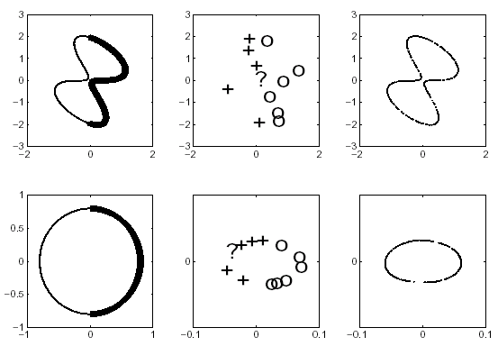
Manifold, unlabeled data help
A
B
Belkin &
Niyogi
2002
A’
B’

Slide 15
Models based on clustering assumption (2): Kernel methods
Objective:
  make the induced distance small for points in the same class and large for those in different classes
  Example:
    Generative: for a mixture of Gaussian one kernel can be defined as
    Discriminative: RBF kernel matrix
Can unify the manifold approach
(Tsuda et al., 2002)

Slide 16
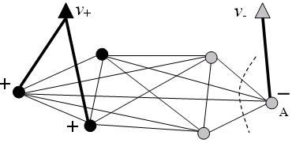
Models based on clustering assumption (3): Min-cut
Express pair-wise relationship (similarity) between labeled/unlabeled data as a graph, and find a partitioning that minimizes the sum of similarity between differently labeled examples.

Slide 17
Min-cut family algorithm
Problems with min-cut
  Degenerative (unbalanced) cut
Remedy
  Randomness
  Normalization, like Spectral Graph Partitioning
  Principle:
  Averages over examples (e.g., average margin, pos/neg ratio) should have the same expected value in the labeled and unlabeled data.

Slide 18
Road map
Introduction: background and application
Semi-supervised learning, esp. for text classification (survey)
Maximum Entropy Models (survey)
Combining semi-supervised learning and maximum entropy models (new)
Summary

Slide 19
Overview:
Maximum entropy models
Advantage of maximum entropy model
  Based on features, allows and supports feature induction and feature selection
  offers a generic framework for incorporating unlabeled data
  only makes weak assumptions
  gives flexibility in incorporating side information
  natural multi-class classification
So maximum entropy model is worth further study.

Slide 20
Feature in MaxEnt
Indicate the strength of certain aspects in the event
  e.g., f_{t} (x, y) = 1 if and only if the current word, which is part of document x, is “back” and the class y is verb. Otherwise, f_{t} (x, y) = 0.
Contributes to the flexibility of MaxEnt

Slide 21

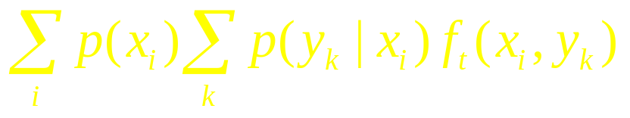
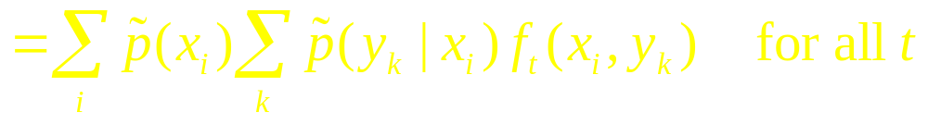
Standard MaxEnt Formulation
maximize
s.t.
The dual problem is just the maximum likelihood problem.

Slide 22
Smoothing techniques (1)
Gaussian prior (MAP)
maximize
s.t.

Slide 23
Smoothing techniques (2)
Laplacian prior (Inequality MaxEnt)
maximize
s.t.
Extra strength: feature selection.

Slide 24
MaxEnt parameter estimation
Convex optimization ☺
Gradient descent, (conjugate) gradient descent
Generalized Iterative Scaling (GIS)
Improved Iterative Scaling (IIS)
Limited memory variable metric (LMVM)
Sequential update algorithm

Slide 25
Road map
Introduction: background and application
Semi-supervised learning, esp. for text classification (survey)
Maximum Entropy Models (survey)
Combining semi-supervised learning and maximum entropy models (new)
Summary

Slide 26
Semi-supervised MaxEnt
Why do we choose MaxEnt?
  1st reason: simple extension to semi-supervised learning
  2nd reason: weak assumption
maximize
s.t.
where

Slide 27
Estimation error bounds
3rd reason: estimation error bounds in theory
maximize
s.t.

Slide 28
Side Information
Only assumptions over the accuracy of empirical evaluation of sufficient statistics is not enough
y
1.
xy
x
O
O
2. Use distance/similarity info

Slide 29
Source of side information
Instance similarity.
  neighboring relationship between different instances
  redundant description
  tracking the same object
Class similarity, using information on related classification tasks
  combining different datasets (different distributions) which are for the same classification task;
  hierarchical classes;
  structured class relationships (such as trees or other generic graphic models)

Slide 30
Incorporate similarity information: flexibility of MaxEnt framework
Add assumption that the class probability of x_{i} , x_{j} is similar if the distance in one metric is small between x_{i} , x_{j}.
Use the distance metric to build a minimum spanning tree and add side info to MaxEnt. Maximize:
where w_{(i,j)} is the true distance between (x_{i}, x_{j})

Slide 31
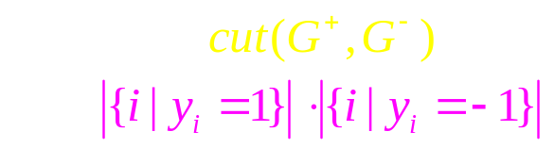
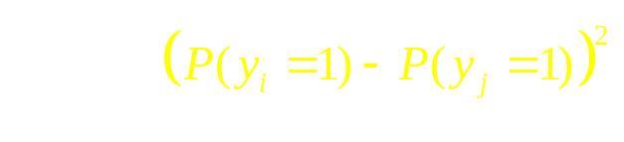
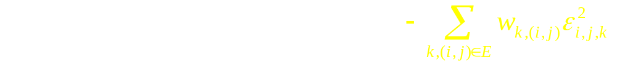

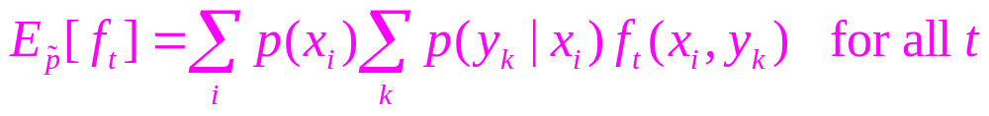
Connection with Min-cut family
Spectral Graph Partitioning
Harmonic function
(Zhu et al. 2003)
minimize
s.t.
maximize

Slide 32
Miscellaneous promising research openings (1)
Feature selection
  Greedy algorithm to incrementally add feature to the random field by selecting the feature which maximally reduces the objective function.
Feature induction
  If IBM appears in labeled data while Apple does not, then using ‘IBM or Apple’ as feature can help (though costly).

Slide 33
Miscellaneous promising research openings (2)
Interval estimation
  How should we set the A_{t} and B_{t} ? Whole bunch of results in statistics. W/S LLN, Hoeffding’s inequality
  or using more advanced concepts in statistical learning theory, e.g., VC-dimension of feature class
minimize
s.t.

Slide 34

Miscellaneous promising research openings (3)
Re-weighting
  In view that the empirical estimation of statistics is inaccurate, we add more weight to the labeled data, which may be more reliable than unlabeled data.
minimize
s.t.

Slide 35
Re-weighting
Originally, n₁ labeled examples and n₂ unlabeled examples
  Then p(x) for labeled data:
  p(x) for unlabeled data:
All equations before keep unchanged!

Slide 36
Initial experimental results
Dataset: optical digits from UCI
  64 input attributes ranging in [0, 16], 10 classes
Algorithms tested
  MST MaxEnt with re-weight
  Gaussian Prior MaxEnt, Inequality MaxEnt, TSVM (linear and polynomial kernel, one-against-all)
Testing strategy
  Report the results for the parameter setting with the best performance on the test set

Slide 37
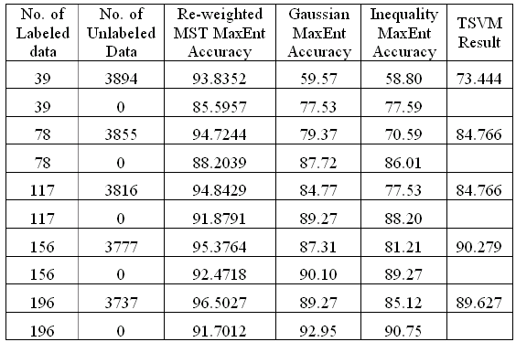
Initial experiment result

Slide 38
Summary
Maximum Entropy model is promising for semi-supervised learning.
Side information is important and can be flexibly incorporated into MaxEnt model.
Future research can be done in the area pointed out (feature selection/induction, interval estimation, side information formulation, re-weighting, etc).

Slide 39

Questions are welcomed.
Question and Answer Session

Slide 40
GIS
Iterative update rule for unconditional probability:
GIS for conditional probability

Slide 41
IIS
Characteristic:
  monotonic decrease of MaxEnt objective function
  each update depends only on the computation of expected values , not requiring the gradient or higher derivatives
Update rule for unconditional probability:
  is the solution to:
  are decoupled and solved individually
  Monte Carlo methods are to be used if the number of possible x_{i} is too large

Slide 42

GIS
Characteristics:
  converges to the unique optimal value of λ
  parallel update, i.e., are updated synchronously
  slow convergence
prerequisite of original GIS
  for all training examples x_{i}: and
  relaxing prerequisite
if
then define
If not all training data have summed feature equaling C, then
set C sufficiently large and incorporate a ‘correction feature’.

Slide 43
Other standard optimization algorithms
Gradient descent
Conjugate gradient methods, such as Fletcher- Reeves and Polak-Ribiêre-Positive algorithm
limited memory variable metric, quasi-Newton methods: approximate Hessian using successive evaluations of gradient

Slide 44
Sequential updating algorithm
For a very large (or infinite) number of features, parallel algorithms will be too resource consuming to be feasible.
Sequential update: A style of coordinate-wise descent, modifies one parameter at a time.
Converges to the same optimum as parallel update.

Slide 45
Dual Problem of Standard MaxEnt
minimize
Dual
problem:
where

Slide 46

Relationship with maximum likelihood
Suppose
where
← maximize
Dual of
MaxEnt:
← minimize

Slide 47
Smoothing techniques (2)
Exponential prior
minimize
s.t.
Dual
problem:
minimize
Equivalent
To maximize

Slide 48
Smoothing techniques (1)
Gaussian prior (MAP)
minimize
s.t.
Dual
problem:
minimize

Slide 49
Smoothing techniques (3)
Laplacian prior (Inequality MaxEnt)
minimize
s.t.
Dual
problem:
minimize
where

Slide 50
Smoothing techniques (4)
Inequality with 2-norm Penalty
minimize
s.t.

Slide 51
Smoothing techniques (5)
Inequality with 1-norm Penalty
minimize
s.t.

Slide 52
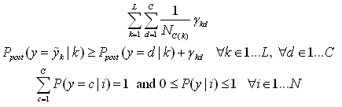
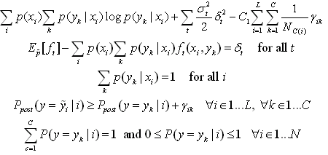
Using MaxEnt as Smoothing
Add maximum entropy term into the target function of other models, using MaxEnt’s preference of uniform distribution
maximize
maximize
s.t.
minimize
s.t.

Slide 53
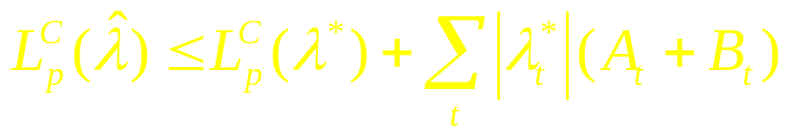
Bounded error
Correct distribution p^{C}(x_{i})
Conclusion:
then

